Slide 1
Computer Networks
By
Lt Col Ishtiaq Kiani
(10 Sep 12 to 12 Jan 13)

Slide 2
PART 3
Data Link Layer

Slide 3
Chapter 11 Data Link Control
Framing
Flow and Error Control
Protocols
Noiseless Channels
Noisy Channels
HDLC
Point to Point Protocols

Slide 4
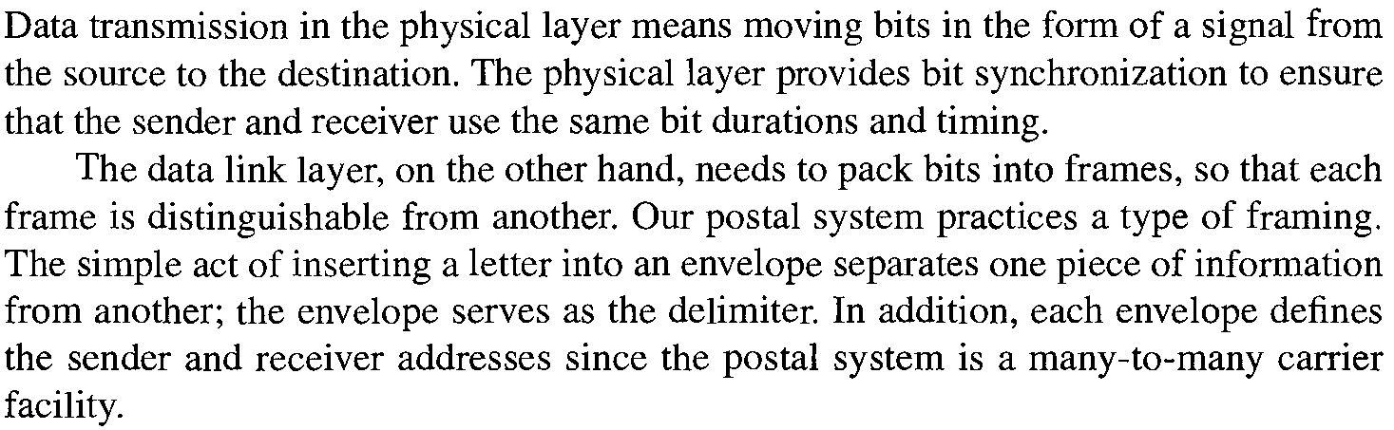
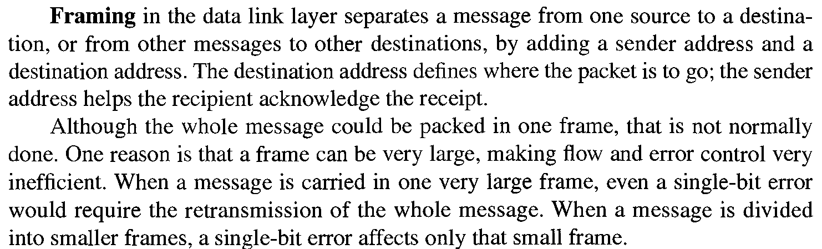
Framing

Slide 5

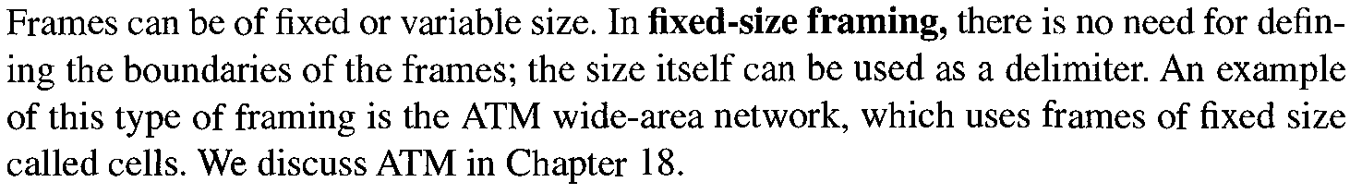

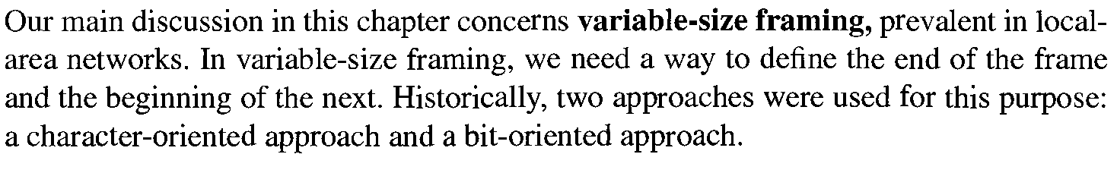
Framing
is about

Slide 6
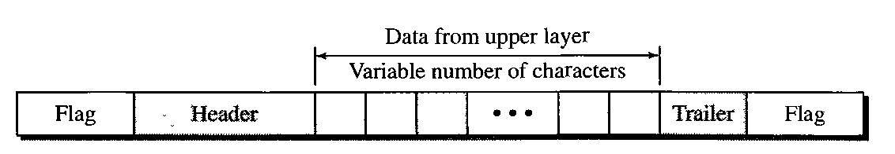
Framing
Character Oriented Protocols

Slide 7
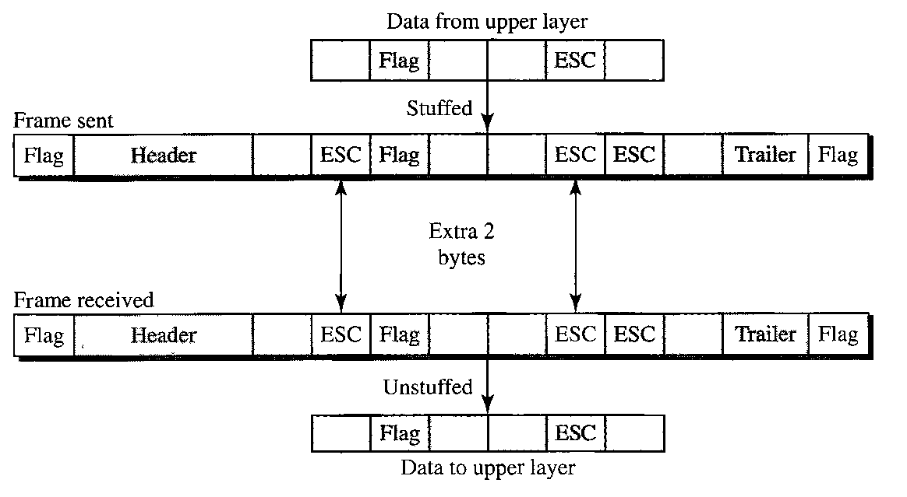
Framing
Byte Stuffing and Un-stuffing

Slide 8
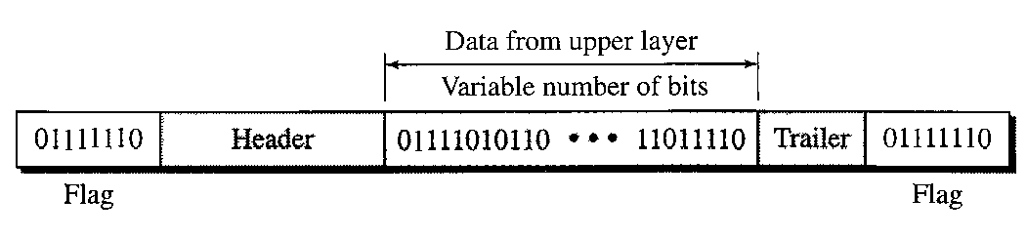
Framing
Bit Oriented Protocols

Slide 9
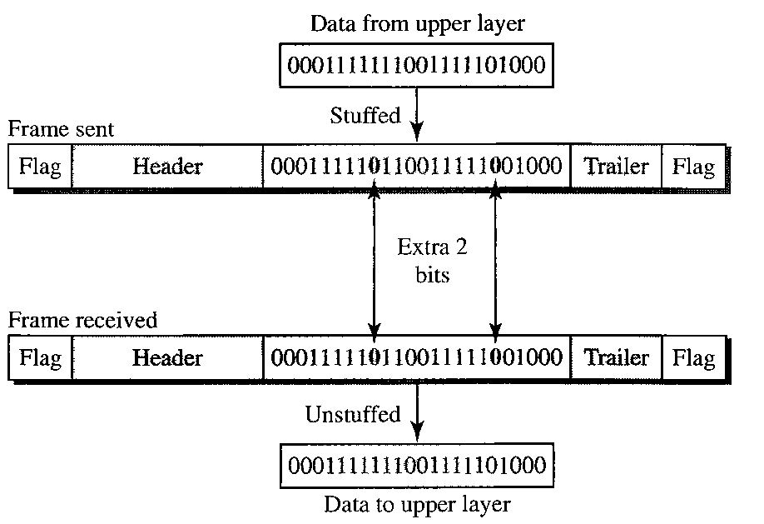
Framing
Byte Stuffing and Un-stuffing

Slide 10
Flow and Error Control
Flow Control
Flow control refers to a set of procedures used to restrict the amount of data that the sender can send before waiting for acknowledgment.
Error Control
Error control in the data link layer is based on automatic repeat request, which is the retransmission of data.

Slide 11
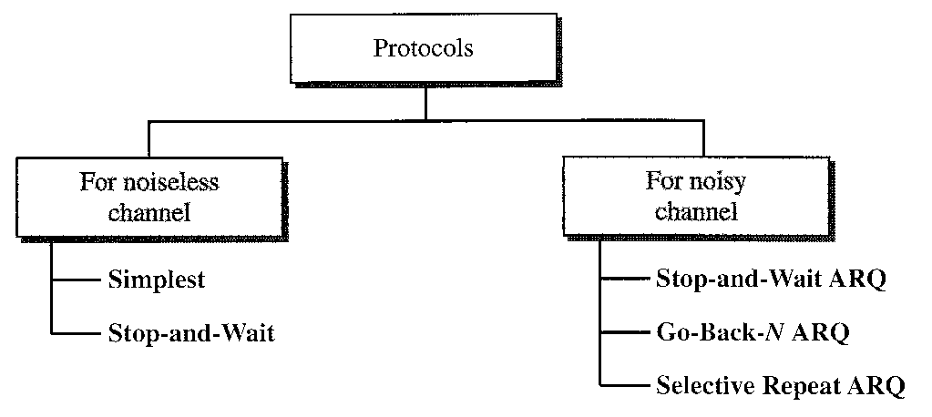
Protocols

Slide 12
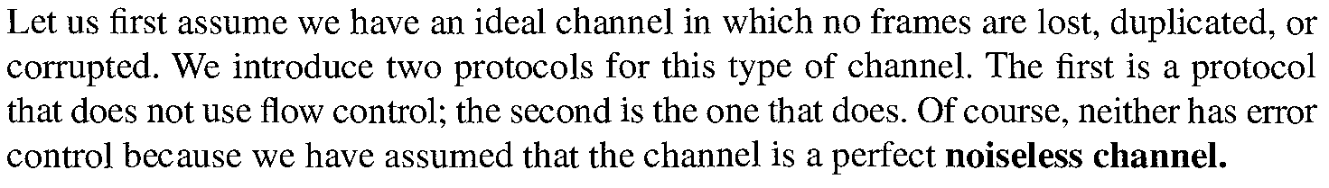
Noiseless Channel

Slide 13
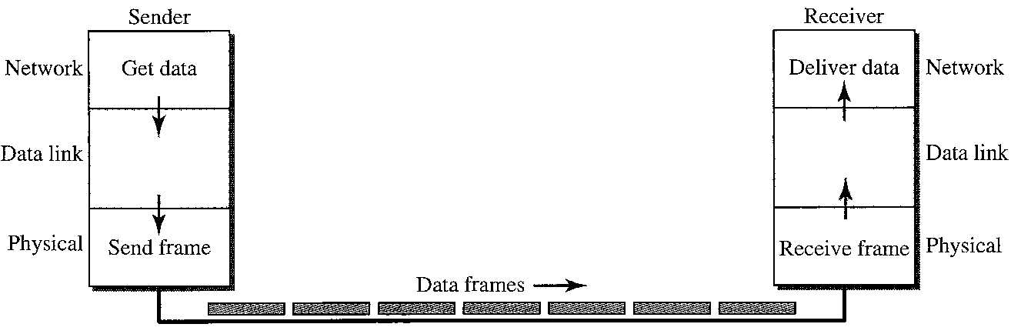
Noiseless Channel
Simplest Protocol

Slide 14

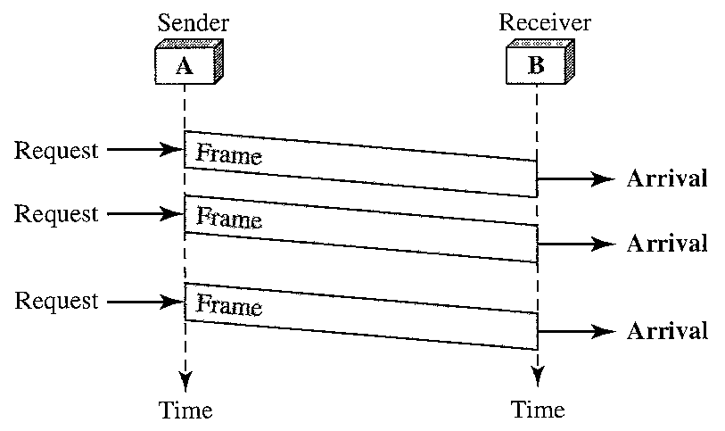
Noiseless Channel
Simplest Protocol

Slide 15
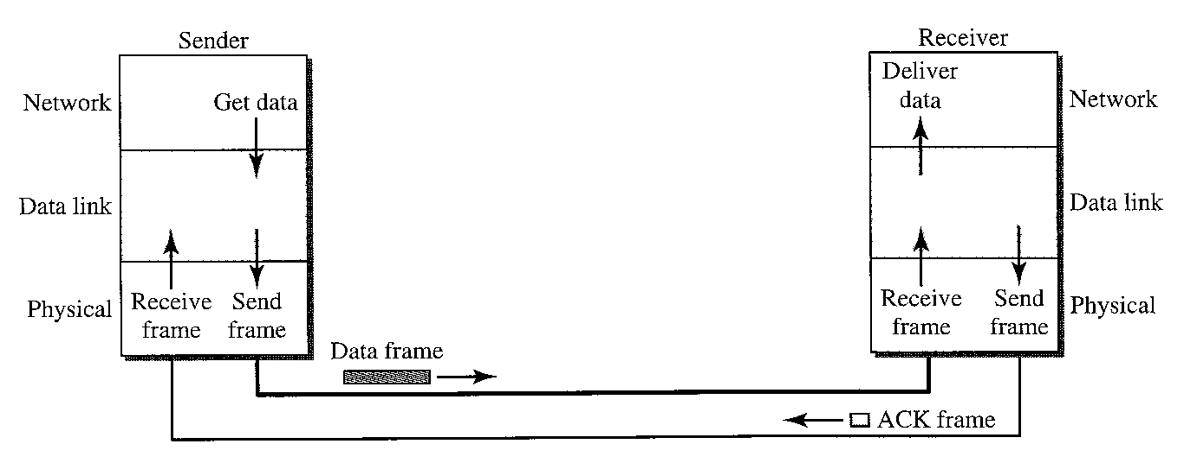
Noiseless Channel
Stop and Wait Protocol

Slide 16
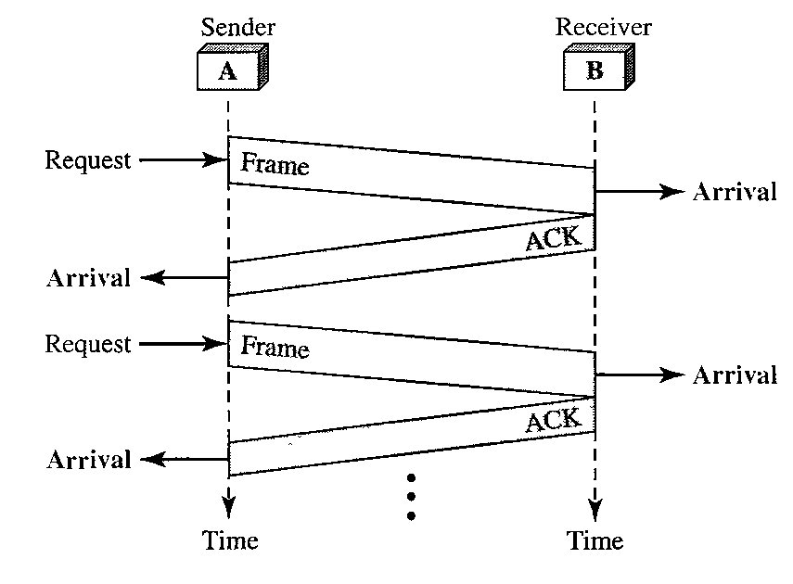
Noiseless Channel
Stop and Wait Protocol

Slide 17
Noiseless Channel
Stop and Wait Protocol

Slide 18
Noisy Channels
Stop and Wait ARQ
In Stop-and-Wait ARQ, numbering frames prevents the retaining of duplicate frames.
Numbered acknowledgments are needed if an acknowledgment is delayed and the next frame is lost.

Slide 19
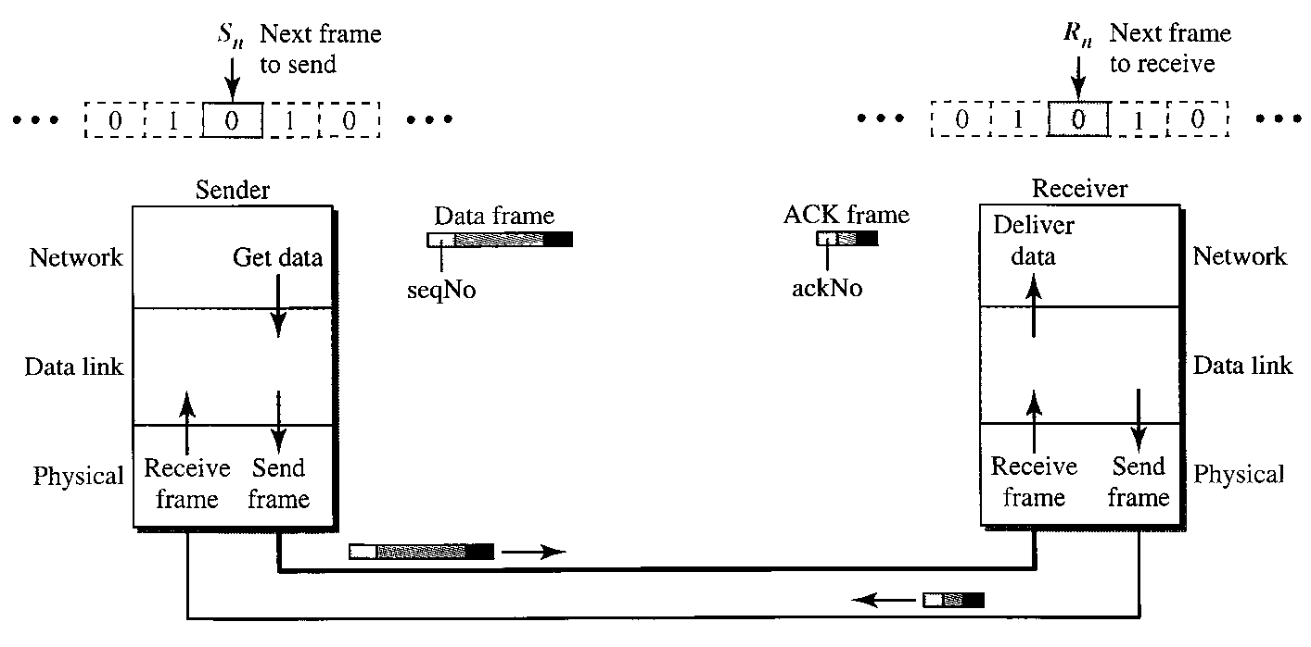
Noisy Channels
Stop and Wait ARQ

Slide 20
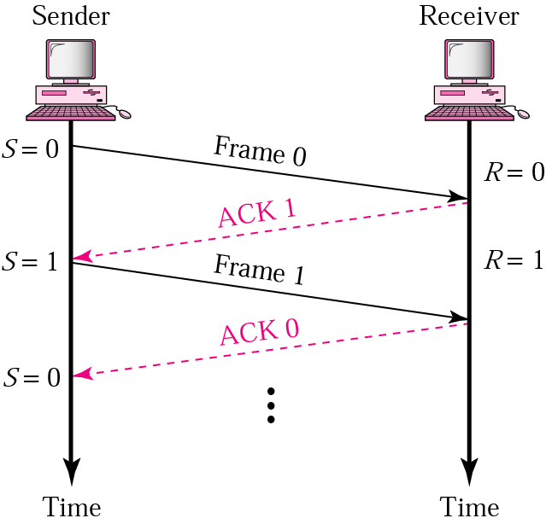
Noisy Channels
Stop and Wait ARQ – Normal Ops

Slide 21
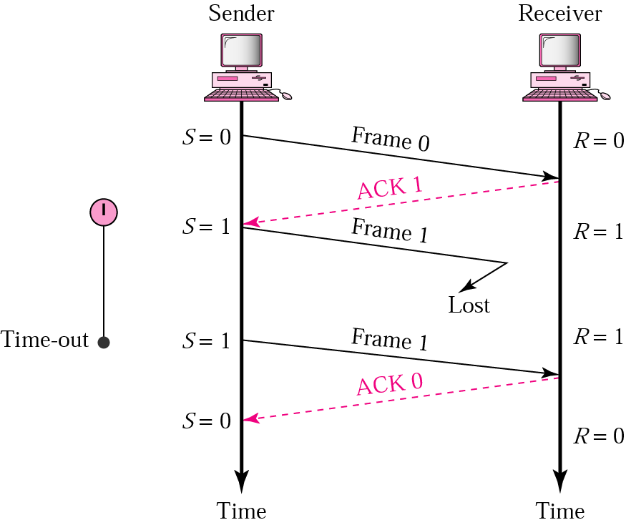
Noisy Channels
Stop and Wait ARQ – Lost Frame

Slide 22
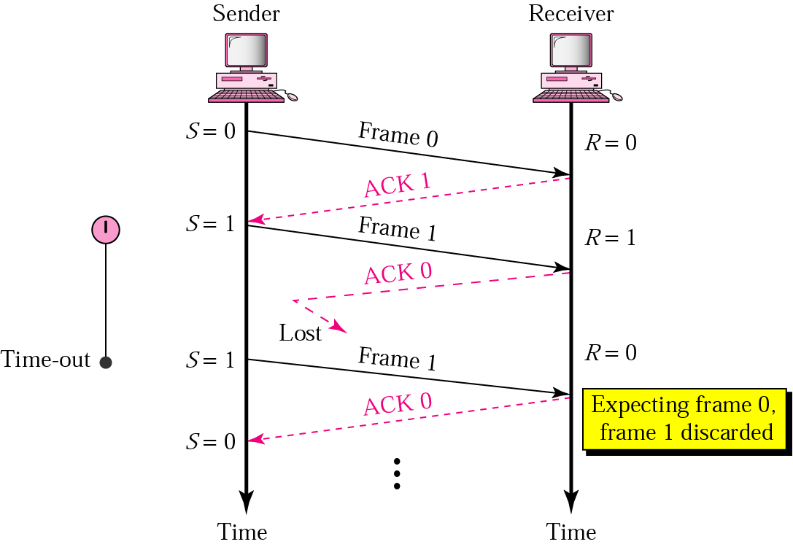
Noisy Channels
Stop and Wait ARQ – Lost Ack Frame

Slide 23
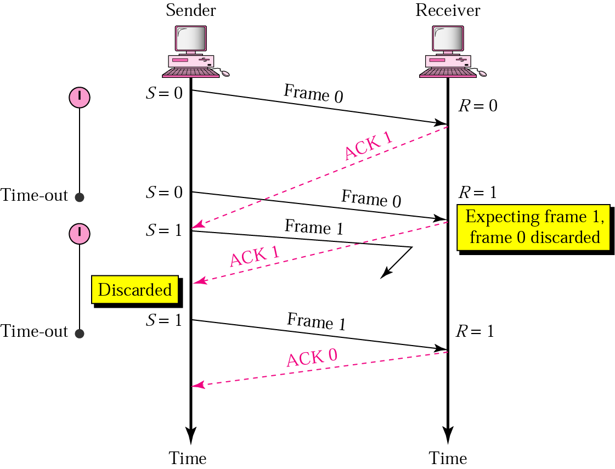
Noisy Channels
Stop and Wait ARQ – Delayed Ack

Slide 24
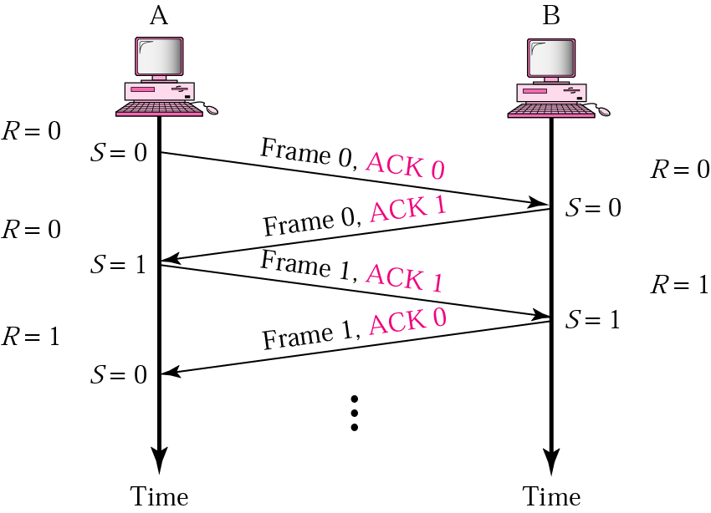
Noisy Channels
Piggybacking

Slide 25
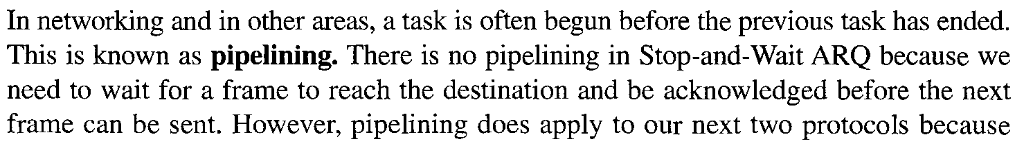
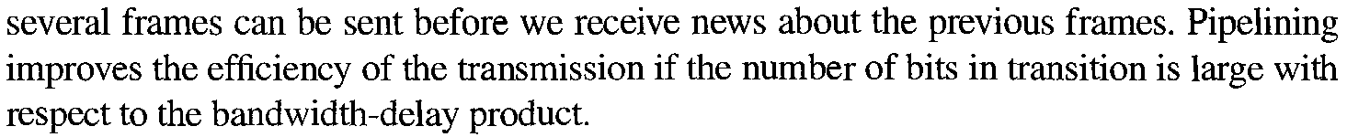
Noisy Channels
Pipelining

Slide 26
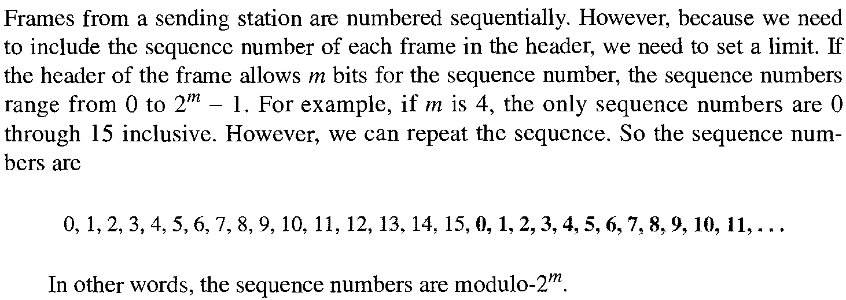
Noisy Channels
Go Back N ARQ - Sequence Number

Slide 27
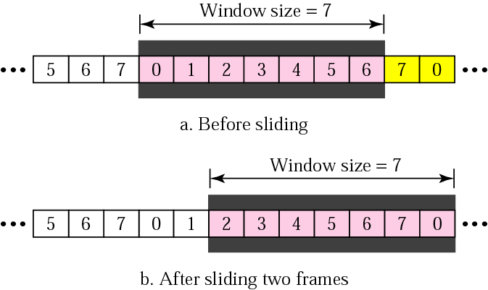
Noisy Channels
Go Back N ARQ – Sender Sliding Window

Slide 28
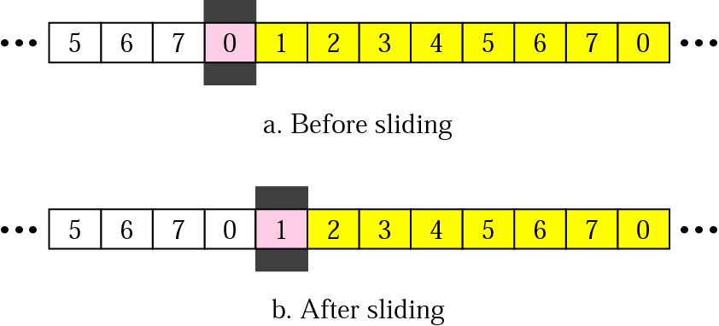
Noisy Channels
Go Back N ARQ – Receiver Sliding Window

Slide 29
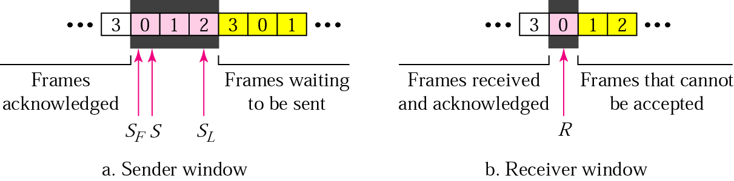
Noisy Channels
Go Back N ARQ – Control Variables

Slide 30
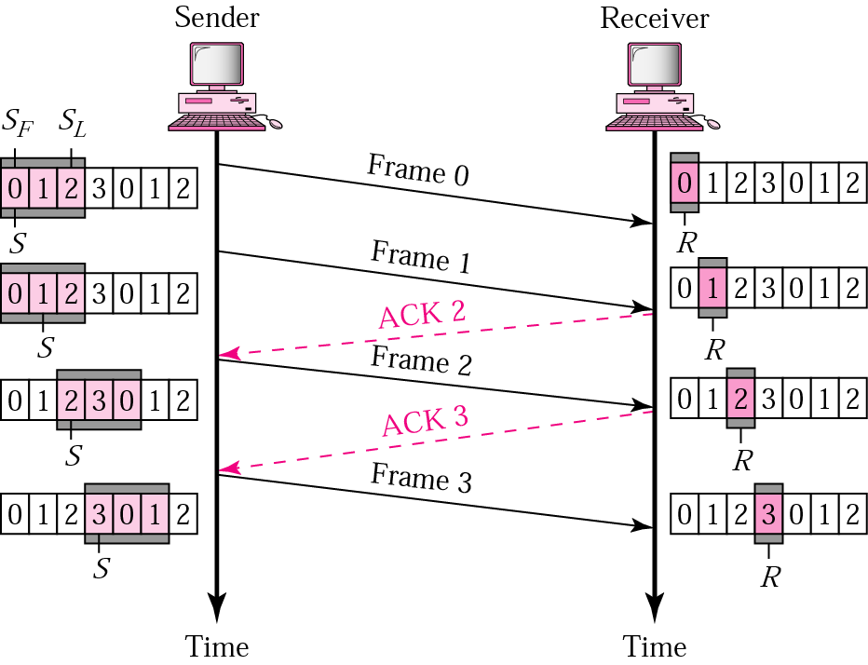
Noisy Channels
Go Back N ARQ – Normal Operation

Slide 31
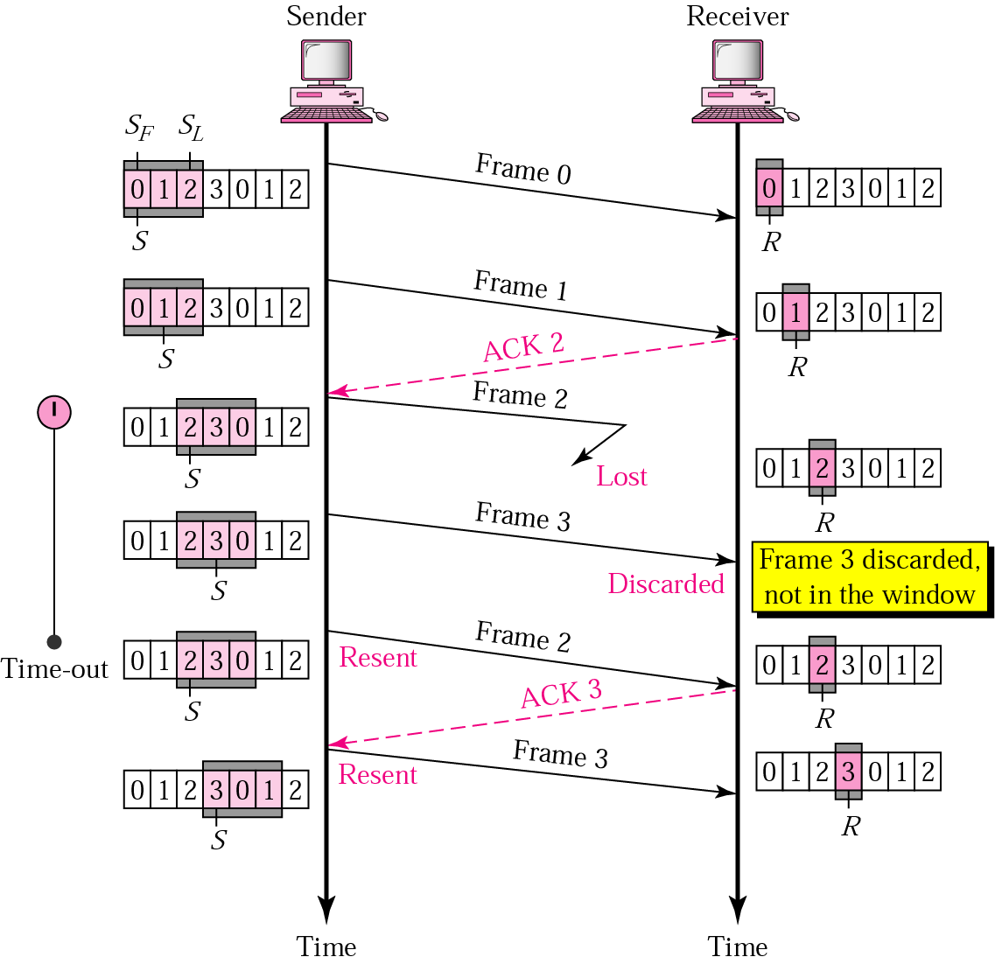
Noisy Channels
Go Back N ARQ – Lost Frame

Slide 32
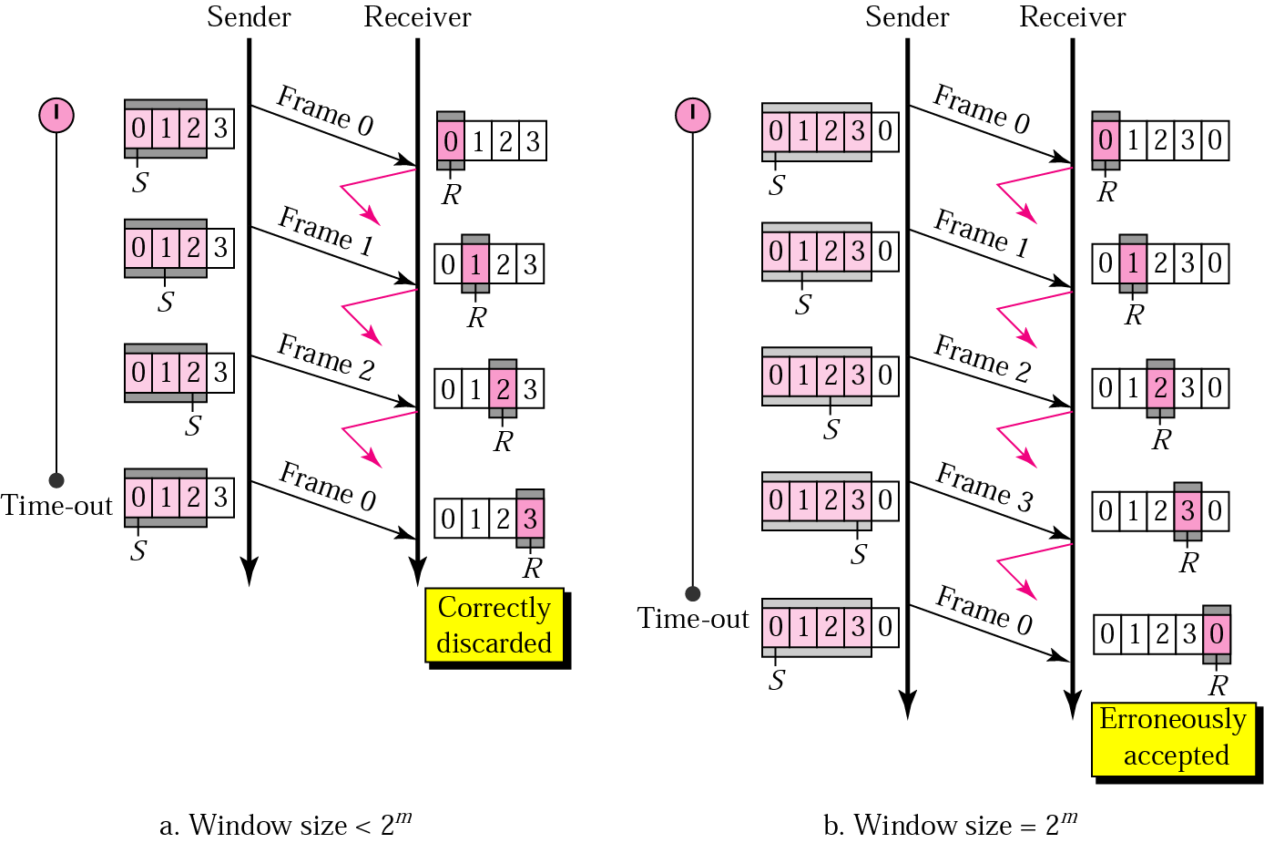
Noisy Channels
Go Back N ARQ – Sender Window Size
In Go-Back-N ARQ, the size of the sender window must be less than 2m; the size of the receiver window is always 1.

Slide 33
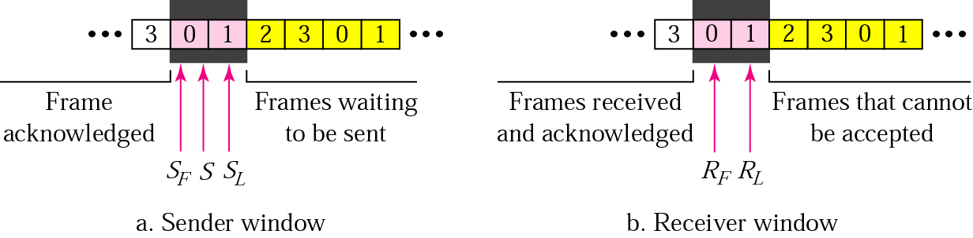
Noisy Channels
Selective Repeat ARQ – Sender and Receiver Windows

Slide 34
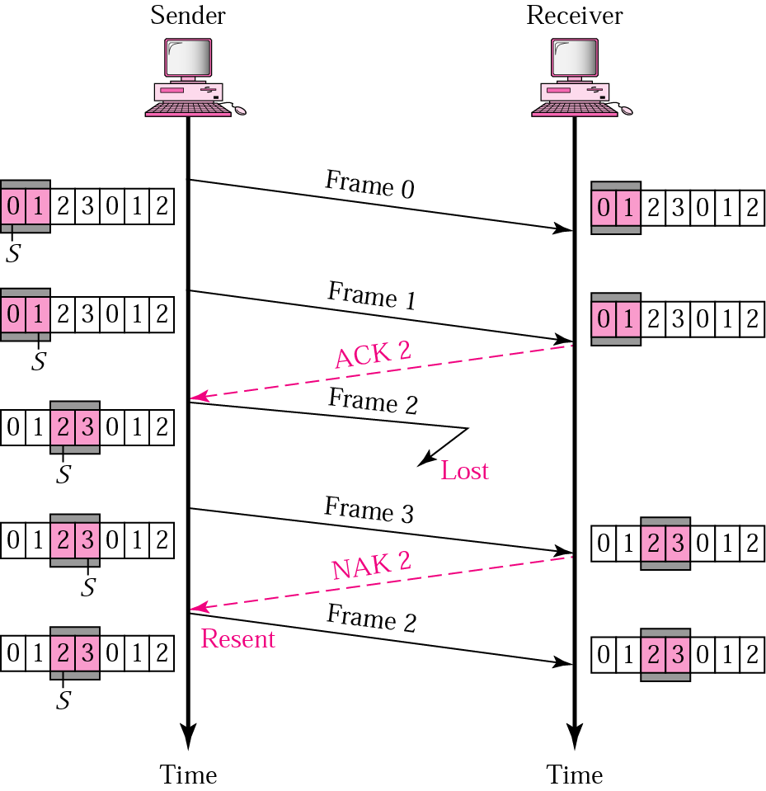
Noisy Channels
Selective Repeat ARQ – Frame Lost

Slide 35
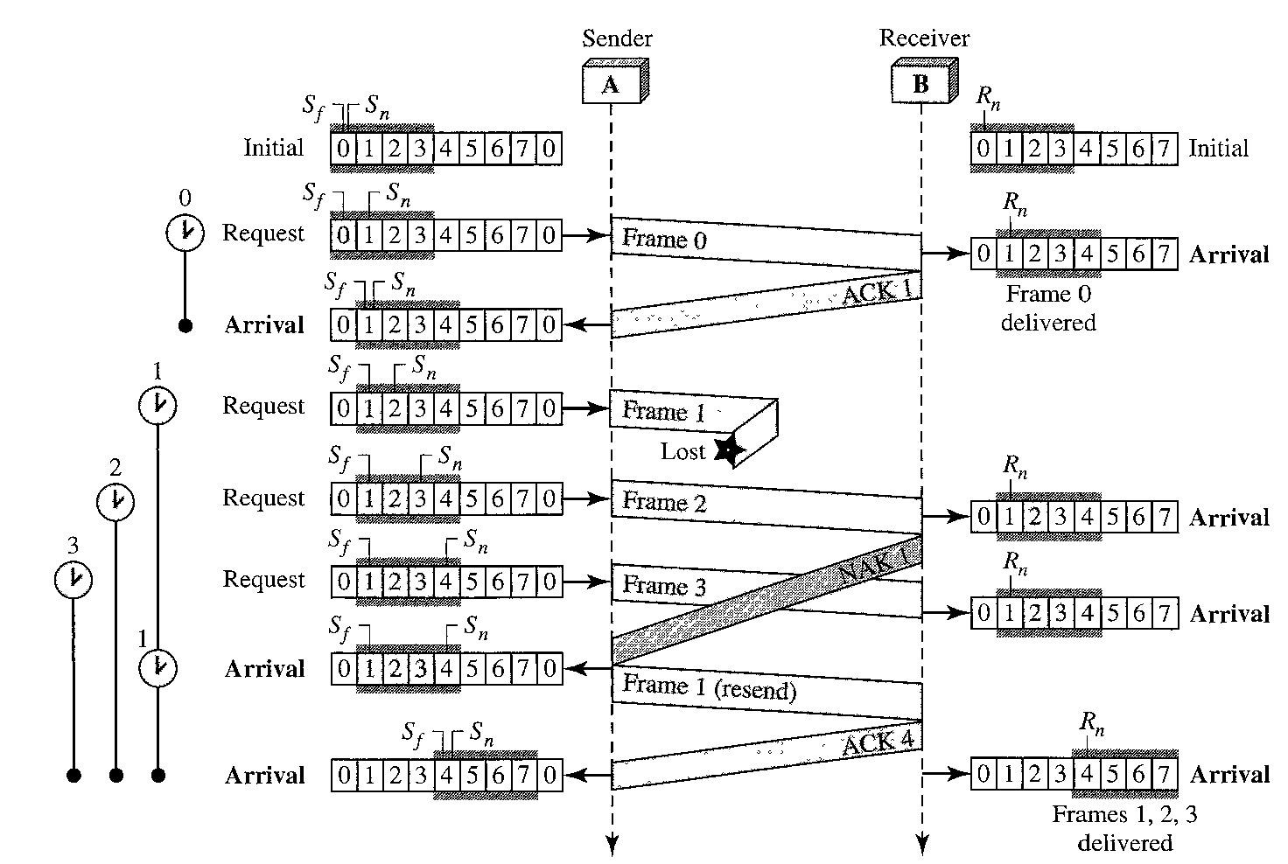
Noisy Channels
Selective Repeat ARQ – Frame Lost

Slide 36
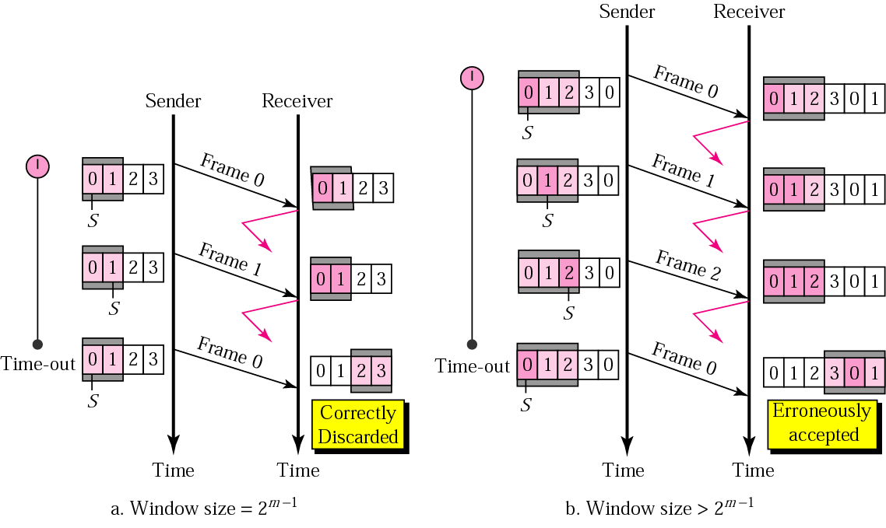
Noisy Channels
Selective Repeat ARQ – Sender Window Size
In Selective Repeat ARQ, the size of the sender and receiver window must be at most one-half of 2^{m}.

Slide 37
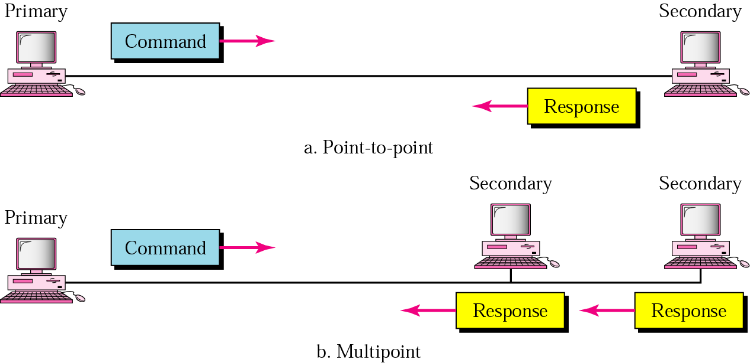
High Level Data Link Control (HDLC)
NRM

Slide 38
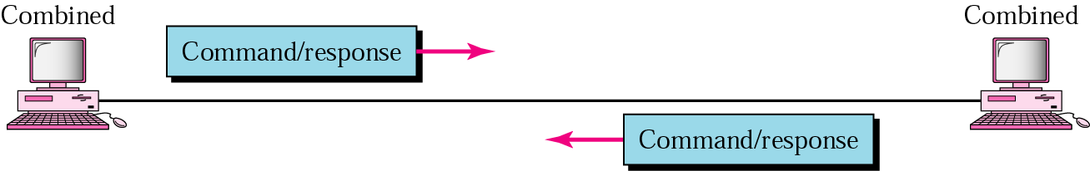
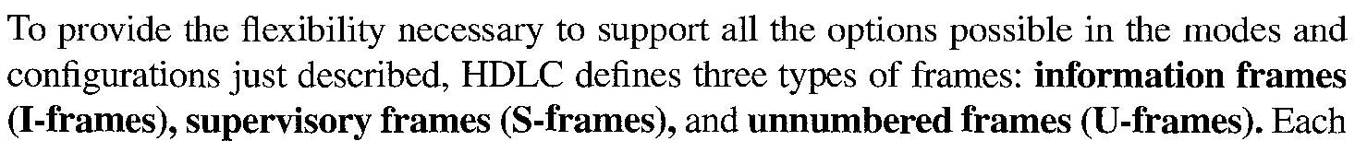
High Level Data Link Control (HDLC)
ABM
Frame

Slide 39
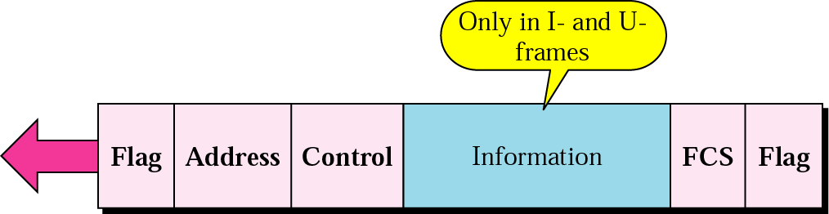
High Level Data Link Control (HDLC)
HDLC Frame

Slide 40
High Level Data Link Control (HDLC)
HDLC Flag Field

Slide 41
High Level Data Link Control (HDLC)
HDLC Address Field

Slide 42
High Level Data Link Control (HDLC)
HDLC Control Field

Slide 43
High Level Data Link Control (HDLC)
HDLC Control Field
Poll/ Final

Slide 44
High Level Data Link Control (HDLC)
HDLC Information Field

Slide 45
High Level Data Link Control (HDLC)
HDLC FCS Field

Slide 46
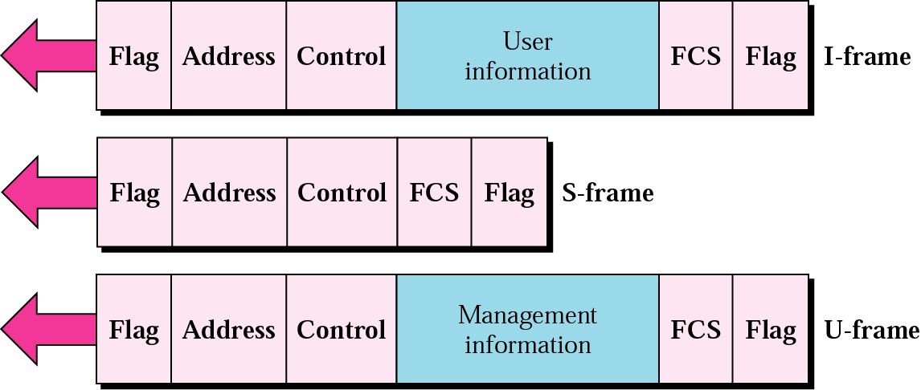
High Level Data Link Control (HDLC)
HDLC Frame Types

Slide 47
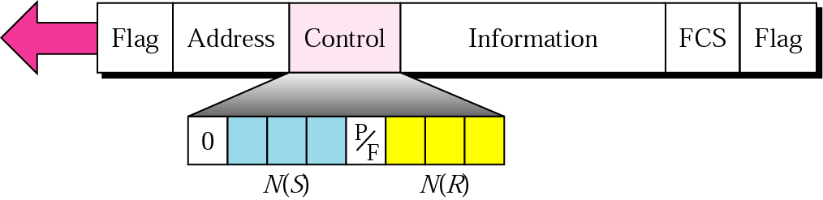
High Level Data Link Control (HDLC)
I Frame

Slide 48
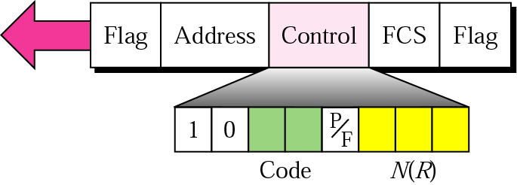
High Level Data Link Control (HDLC)
S Frame

Slide 49
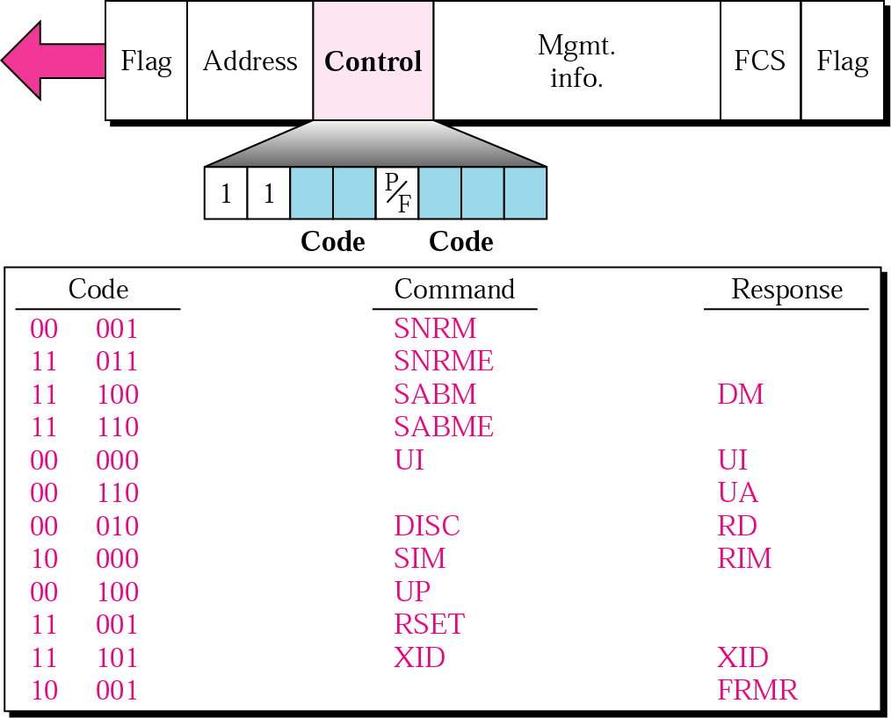
High Level Data Link Control (HDLC)
U Frame

Slide 50
High Level Data Link Control (HDLC)
U Frame Control Command and Response
Command/response | Meaning
SNRM | Set normal response mode
SNRME | Set normal response mode (extended)
SABM | Set asynchronous balanced mode
SABME | Set asynchronous balanced mode (extended)
UP | Unnumbered poll
UI | Unnumbered information
UA | Unnumbered acknowledgment
RD | Request disconnect
DISC | Disconnect
DM | Disconnect mode
RIM | Request information mode
SIM | Set initialization mode
RSET | Reset
XID | Exchange ID
FRMR | Frame reject

Slide 51
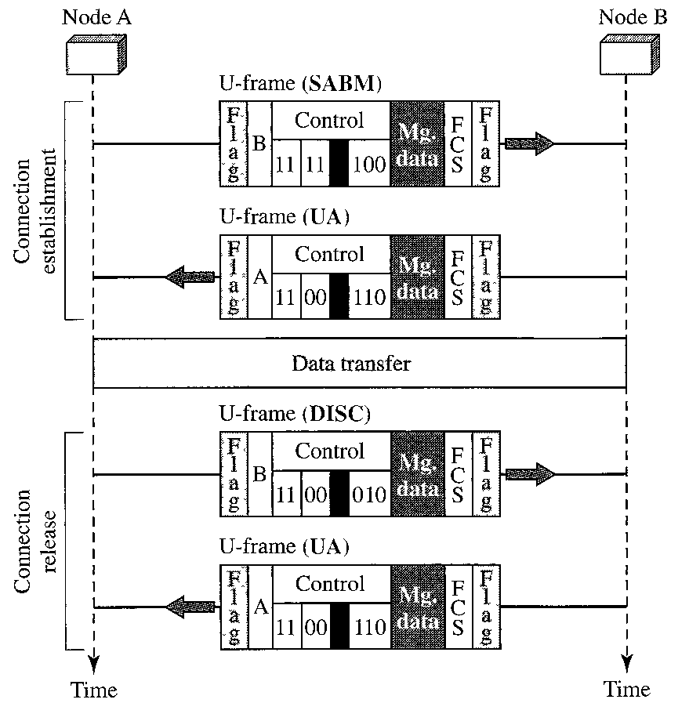
High Level Data Link Control (HDLC)
Connection and Disconnection

Slide 52
High Level Data Link Control (HDLC)
Example
Figure 11.22 shows an exchange using piggybacking where is no error. Station A begins the exchange of information with an I-frame numbered 0 followed by another I-frame numbered 1. Station B piggybacks its acknowledgment of both frames onto an I-frame of its own. Station B’s first I-frame is also numbered 0 [N(S) field] and contains a 2 in its N(R) field, acknowledging the receipt of A’s frames 1 and 0 and indicating that it expects frame 2 to arrive next. Station B transmits its second and third I-frames (numbered 1 and 2) before accepting further frames from station A. Its N(R) information, therefore, has not changed: B frames 1 and 2 indicate that station B is still expecting A frame 2 to arrive next.

Slide 53
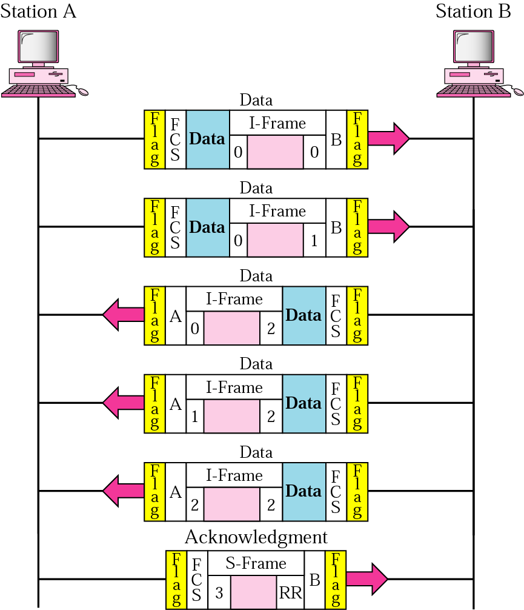
High Level Data Link Control (HDLC)
Example

Slide 54
High Level Data Link Control (HDLC)
Example
In Example 3, suppose frame 1 sent from station B to station A has an error. Station A informs station B to resend frames 1 and 2 (the system is using the Go-Back-N mechanism). Station A sends a reject supervisory frame to announce the error in frame 1. Figure 11.23 shows the exchange.

Slide 55
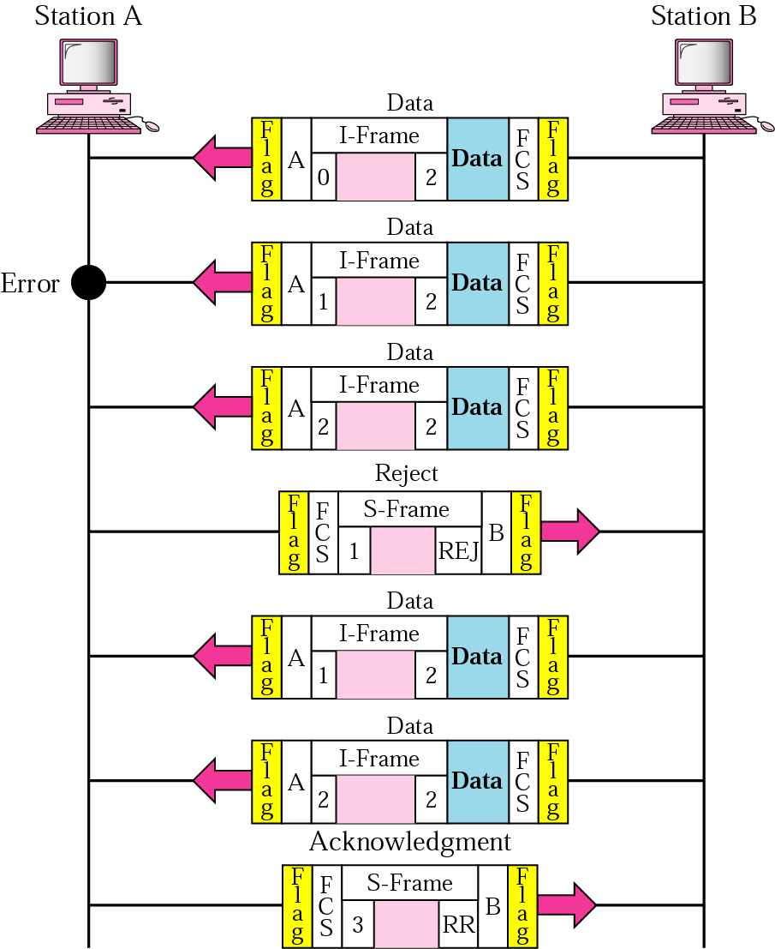
High Level Data Link Control (HDLC)
Example

Slide 56
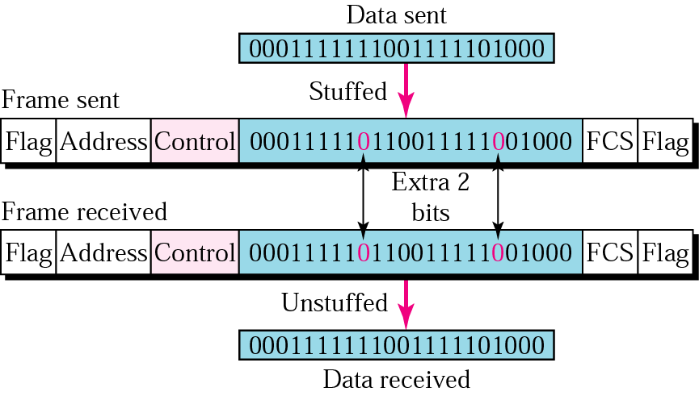
High Level Data Link Control (HDLC)
Bit Stuffing and Removal
Bit stuffing is the process of adding one extra 0 whenever there are five consecutive 1s in the data so that the receiver does not mistake the data for a flag.

Slide 57
High Level Data Link Control (HDLC)
Bit Stuffing

Slide 58
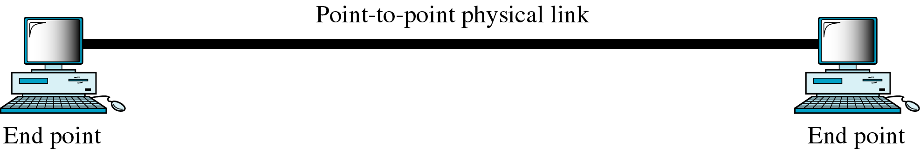
Point to Point Protocol (PPP)
Link

Slide 59
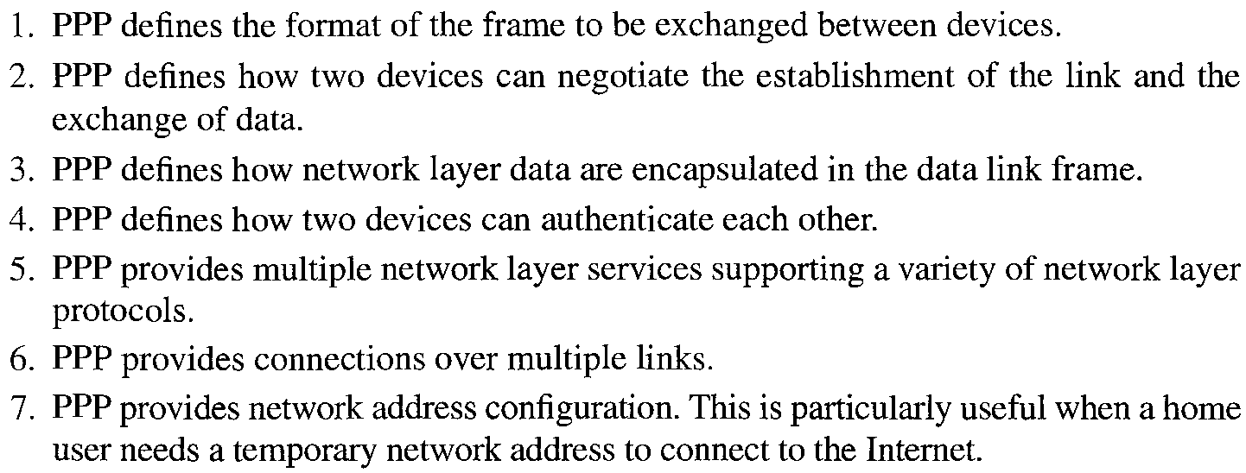
Point to Point Protocol
Services of PPP

Slide 60
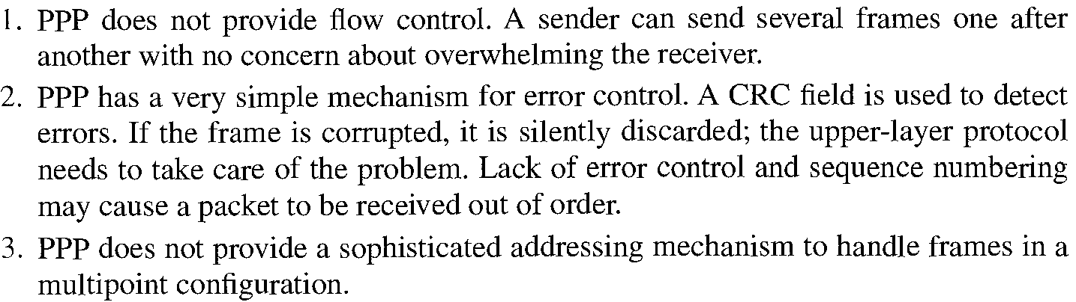
Point to Point Protocol
Missing Services

Slide 61
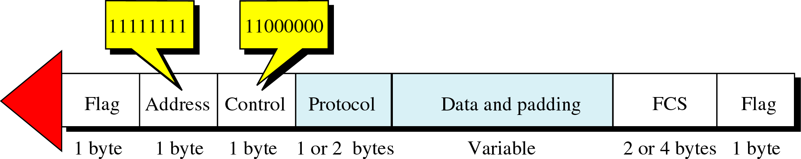
Point to Point Protocol
PPP Frame

Slide 62
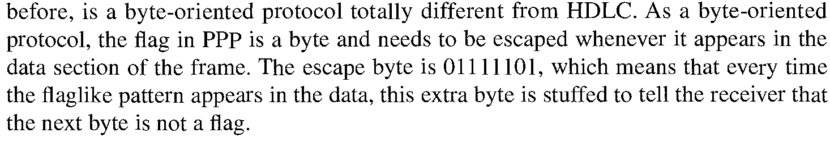
Point to Point Protocol
Byte Stuffing
PPP

Slide 63

Point to Point Protocol
PPP Transition Phases

Slide 64

Point to Point Protocol
Multiplexing

Slide 65

Point to Point Protocol
Multiplexing

Slide 66

Point to Point Protocol
LCP Packet

Slide 67
Point to Point Protocol
LCP Packet and their Code
Code | Packet Type | Description
01₁₆ | Configure-request | Contains the list of proposed options and their values
02₁₆ | Configure-ack | Accepts all options proposed
03₁₆ | Configure-nak | Announces that some options are not acceptable
04₁₆ | Configure-reject | Announces that some options are not recognized
05₁₆ | Terminate-request | Requests to shut down the line
06₁₆ | Terminate-ack | Accepts the shut down request
07₁₆ | Code-reject | Announces an unknown code
08₁₆ | Protocol-reject | Announces an unknown protocol
09₁₆ | Echo-request | A type of hello message to check if the other end is alive
0A₁₆ | Echo-reply | The response to the echo-request message
0B₁₆ | Discard-request | A request to discard the packet

Slide 68
Point to Point Protocol
LCP Packet – Common Options
Option | Default
Maximum receive unit | 1500
Authentication protocol | None
Protocol field compression | Off
Address and control field compression | Off

Slide 69

Point to Point Protocol
Authentication Protocol (AP)

Slide 70


Point to Point Protocol
Password Authentication Protocol (PAP)

Slide 71

Point to Point Protocol
PAP Packet

Slide 72

Point to Point Protocol
Challenge Handshake Authentication Protocol (CHAP)

Slide 73

Point to Point Protocol
CHAP Packet

Slide 74

Point to Point Protocol
Internet Protocol Control Protocol (IPCP)

Slide 75
Point to Point Protocol
Code Values for IPCP Packet
Code | IPCP Packet
01 | Configure-request
02 | Configure-ack
03 | Configure-nak
04 | Configure-reject
05 | Terminate-request
06 | Terminate-ack
07 | Code-reject

